Slide 1

Swarm Robotics
Name: SHAMHAN MUAADH MOHAMMED
MATRIC NO.1716219

Slide 2
History of swarm robotics
In swarm robotics multiple robots collectively solve problems by forming advantageous structures and behaviors similar to the ones observed in natural systems, such as swarms of bees, birds, or fish.
The term ’swarm’ was first used in robotics by G. Beni and Fukuda in 1988. According to G. Beni, cellular robotics is composed of autonomous robots that operate in an n-dimensional cellular space without any central entity. Additionally, they coordinate and cooperate to accomplish common goals.
Fokuda used a swarm as a group of robots to work together like the cells of a human body. As a result, they could accomplish very complex goals. A year later, G. Beni and J. Wang introduced ‘swarm intelligence,’ claiming that cellular robotic systems could show intelligent behavior by coordinating their actions.

Slide 3
History of swarm robotics
Early swarm robotic systems explored swarming behaviors in species like ants, birds, fish, and others. The researchers examined these behaviors, exploring the ways how to realize these behaviors in different robotic systems. Additionally, research was driven by different inspirations, like the flocking of birds or colonies of ants.
Many studies and researches emulated swarming behaviors like foraging, flocking, sorting, stigmergy, or cooperation, which refers to the indirect communication amongst species like termites. Stigmergy was first explored in detail in two research papers: “From local actions to global tasks: Stigmergy and collective robotics” (1994) and “Stigmergy, self-organization, and sorting in collective robotics” (1999). The first study in 1994 illustrated several experiments where mobile robots collect randomly distributed objects in an environment via stigmergy. The second paper explored the feature of stigmergy and self-organization amongst robots, having the same capabilities.

Slide 4
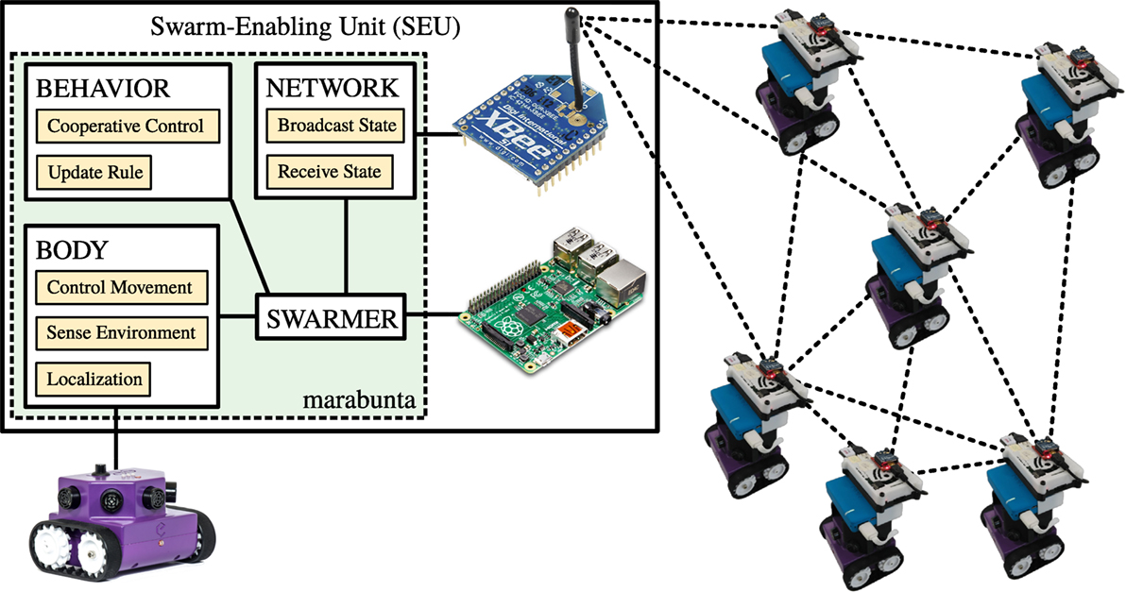
System Architecture

Slide 5
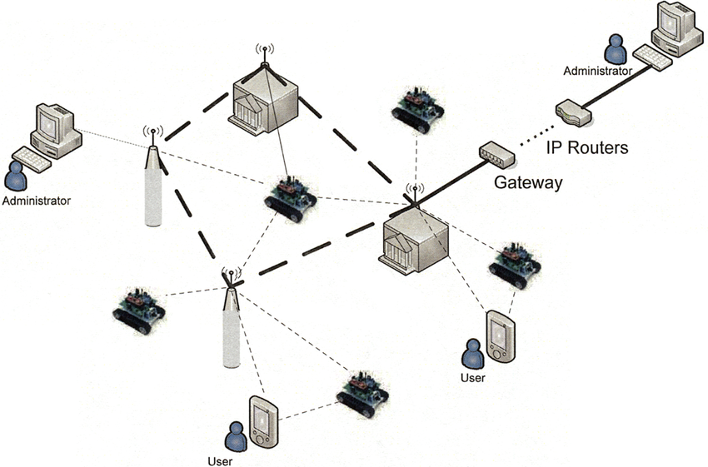
System Architecture

Slide 6
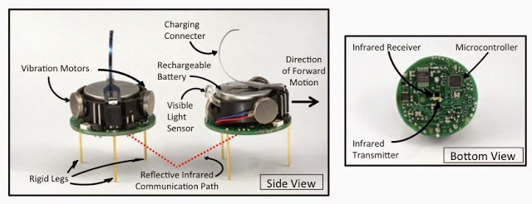
System Architecture

Slide 7
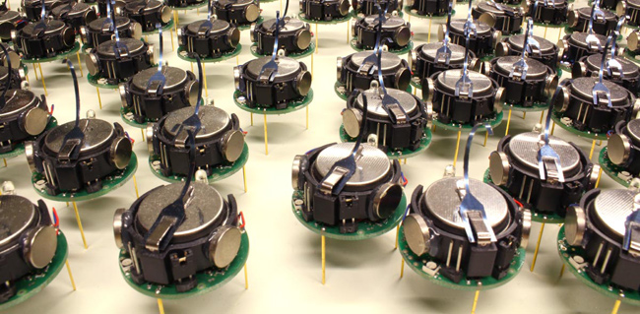
Robot Design Vs. Task
The Kilobot is a 3.3 cm tall low-cost swarm robot[1] developed by Radhika Nagpal and Michael Rubenstein at Harvard University. They can act in groups, up to a thousand, to execute commands programmed by users that could not be executed by individual robots. A problem with research on robot collectives is that the cost of individual units is high. The Kilobot's total cost of parts is under $15. In addition to low cost, it has applications such as collective transport, human-swarm interaction, and shape self-assembly.
the Kilobot is meant to simulate swarms of insects, in that each Kilobot works with the whole to perform tasks that would not work on an individual level. The Kilobots are capable of collective transport, which is the movement of a large object by working together.

Slide 8
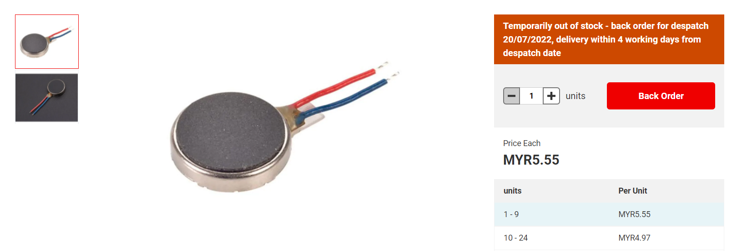
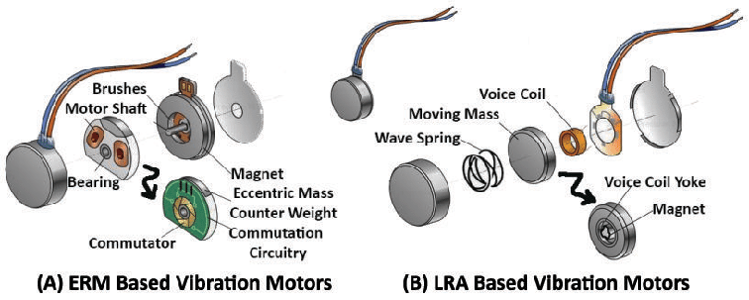
Actuators and Locomotion
Each Kilobot has 2 vibration motors, which are independently controllable, allowing for differential drive of the robot.
Each motor can be set to 255 different power levels.

Slide 9
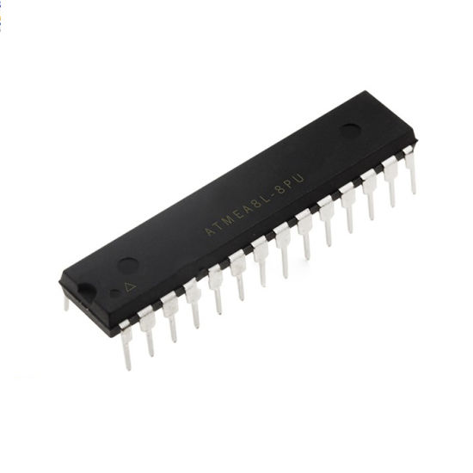
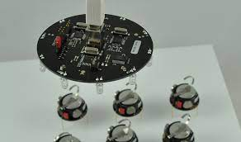
Navigation System and Controller
The microcontroller used in kilobot robots is ATmega 328P (8bit @ 8MHz)
When receiving a message, distance to the transmitting Kilobot can be determined using received signal strength. The brightness of the ambient light shining on a Kilobot can be detected using light sensor.

Slide 10
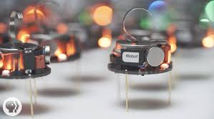
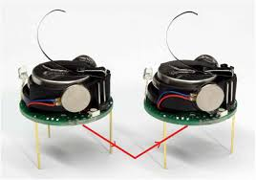
Data Collection and Data Transmissin
Each Kilobot has a red/green/blue (RGB) LED pointed upward, and each color has 3
levels of brightness control.
Kilobots can communicate with neighbors up to 7 cm away by reflecting infrared (IR) light off the ground surface.
The data is collected using infrared receiver and transmitted using infrared transmitter
Some drawbacks of these methods of communication and movement are: the area on which the Kilobot works is limited to flat surfaces and the inability to move precisely over long distances or over an extended period of time.

Slide 11
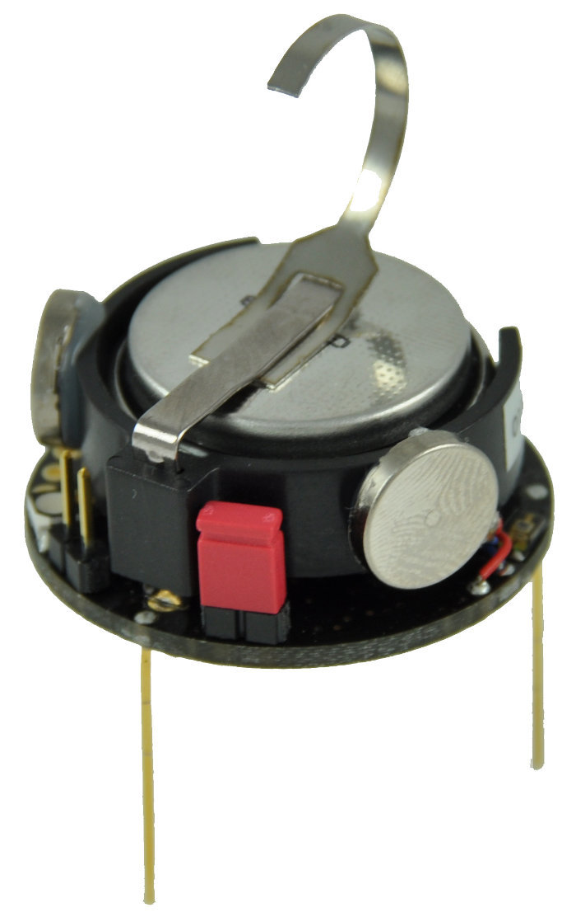
Power system
Rechargeable Li-Ion 3.7V, for a 3 months autonomy in sleep mode. About 2.5 hours in standard use with motors.
Each Kilobot has a built-in charger, which charges the onboard battery when +6 volts is applied to any of the legs, and GND is applied to the charging tab.
Charging time is about 3 hours

